Slide 1
Microservices and DevOps
Scalable Microservices
Mandatory 2.1
Splitting SkyCave – From Three tier to µService
Henrik Bærbak Christensen

Slide 2
SkyCave Architecture
SkyCave was never conceived as a MS architecture
  And designed as a classic three-tier architecture
    UI -> Application -> Persistence
    Cmd -> PlayerServant -> CaveStorage
But I design in the responsibility-centric perspective
  Roles that encapsulate cohesive responsibilities
  Roles as Program to an Interface
    Cave, Player, CaveStorage, …
  Collaboration through Favor Object Composition

Slide 3
SkyCave Architecture
If you review the central Player role, it is actually kind of a Mediator, API Gateway, type role
  A player deals with different aspects of the cave experience, and the Player role encapsulate the interaction with these ‘sub roles’
    I dig a room to the north Modifying the Room Matrix/Cave
    I post a message here Modifying the Wall messages
    I move to a new room Modifying the Player’s own data
These sub-responsibilities (sh/c)ould have been extracted into sub-roles, each with their own interface…

Slide 4
Sub-Responsibilities
… related to Rooms
  CaveStorage: addRoom, getRoom, getSetOfExitsFromRoom, updateRoom
... related to Players
  CaveStorage: getPlayerByID, computeListOfPlayersAt, updatePlayerRecord
... related to Messages
  CaveStorage: addMessage, updateMessage, getMessageList
And they are actually completely orthogonal to each other
  Ideal borderlines for services (But, no real shared models ☹)

Slide 5
Service Responsibilities
… related to Rooms
  CaveStorage: addRoom, getRoom, getSetOfExitsFromRoom, updateRoom
... related to Players
  CaveStorage: getPlayerByID, computeListOfPlayersAt, updatePlayerRecord
... related to Messages on the wall
  CaveStorage: addMessage, updateMessage, getMessageList
CaveService
PlayerService
MessageService

Slide 6
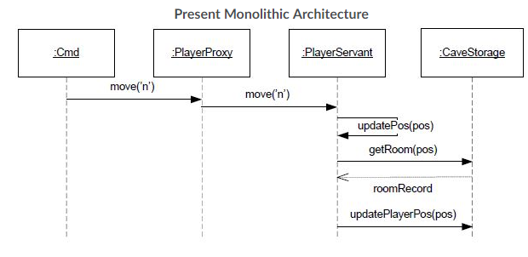
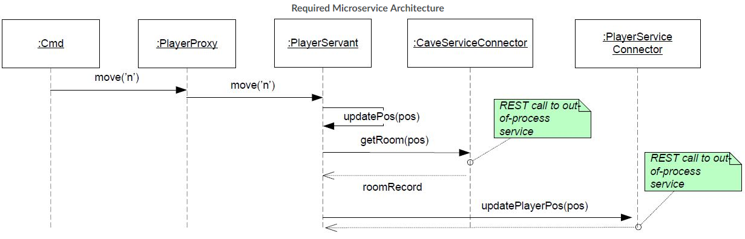
So – The Exercise is…
To modernize/migrate SkyCave to a µService architecture…
From…
To…

Slide 7
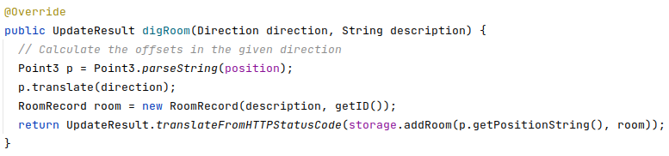
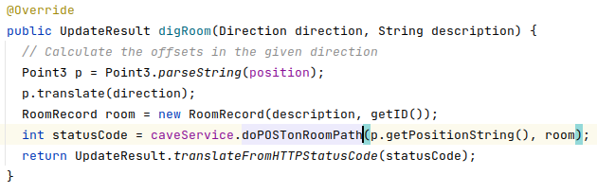
NewPlayerServant
Presently PlayerServant simply interact with CaveStorage
Refactoring PlayerServant into ‘API Gateway’ kind of abstraction
  Strangler pattern

Slide 8
Which boils down to
… a number of parts

Slide 9
DevOps…
You do not do it alone
  Three groups collaborate
    A produces CaveService and associated CDT
    B produces MessageService + CDT
    C produces PlayerService + CDT
  And all validate the API protocol by review
  And then you strangle the Player by consuming the three micro services…
    Creating connectors to Cave-, Message- and PlayerService…
    And refactor the PlayerImplemention…

Slide 10
The Parts
Each group will solve
  Create and Document a REST API for your assigned MicroService; and incorporate improvements and suggestions from your consuming groups.
  Develop Contract Tests (CDTs) in Java/JUnit/TestContainers that verify and document the developed REST API - and provide your consuming groups with these CDTs.
  Develop your assigned micro service (either Cave-, Message-, or PlayerService), and provide it as a docker hub image to your consuming groups.
  Strangle the SkyCave daemon, so a new implementation of the Player interface (a "StrangledPlayerServant") becomes an API Gateway that interacts with Cave-, Player-, and MessageServices (your own + two consumed services; and notably the CaveStorage interface and implementations are eliminated. This will also entail developing Connector Tests for the connectors to the three services.
  Deploy to production. Crunch will come by…

Slide 11
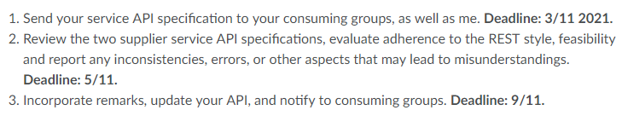
Create/Document API
To get going, I have defined a milestone plan with dates
If you have problems with the dates, please talk to each other (and me) about finding new dates…
APIs are required to be REST format
  Use POST and GET, do not just do URI Tunneling

Slide 12
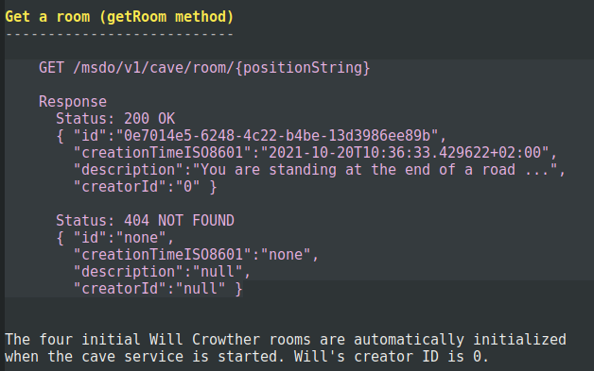
Format
API specification in ‘FRDS §7.7’ format unless all three groups decides otherwise (OpenAPI or what have you).
  Not a precise format but…
I do not want to force yet another
learning curve on you
  If all agree you can do as you please,
  but only if all agree…

Slide 13
CDT and Service Development
Develop CDT
  In Java and TestContainers !
    And provide that to your consuming groups
      Git repo, or source files + gradle dependencies
Develop the Service itself
  In any toolstack you wish
  Provide a docker image for it, to consuming groups (+me)
    Code and docker image may be public
  Must be configurable to allow either
    FakeObject- or NoSQL persistence
      Env variables, command line argument, CPF file, what-have-you

Slide 14
Connector Tests
Do not issue Http requests directly in you new PlayerServant
  Program to an Interface !
So
  Develop XServiceConnectors for the three services
    (Interface (+ FakeObject) + Real REST connector)
      The interface for each is almost given by cutting CaveStorage into three…
  Develop out-of-process Integration tests (connector tests)
Hint: By making a FakeObject implementation, you can start the Strangling even before you get the external services!

Slide 15
Finalize Service Persistence
Develop the persistence layer
  Using any NoSQL of your choose
    Redis, MongoDB, Cassandra, Riak, …
Meaning real deployment requires a compose-file
Optional for 1-person groups

Slide 16
Strangling
Do a step-wise strangling of the Player role
  … one service at a time
FakeCaveStorage

Slide 17
Program To Interface…
Note: These individual parts/steps can be done in (almost) any order!
  You can start Strangling, before you have the service API and images!
Fake CaveService
ProxyPlayerService
FakeCaveStorage

Slide 18
Deliver…
Develop a compose-file for the full SkyCave daemon stack
… and deploy it to your prod server…
  Free to forget old data, migrating data is hell-on-earth…
Two options actually…
  Your stack deploys all services
  Your stack refers to external group’s deployed services
    Will have an interesting implication on what users see ☺

Slide 19
Hints and Help

Slide 20
Experience from Last Time
The Connector + Strangling part is not ‘difficult’ but requires some time
  Last time, people suddenly got very busy 4 days before deadline…
Take care while Strangling
  It is easy to ‘start in 10 ends and end up in big-ball-of-mud’
    “I introduce the message connector in my player servant which becomes a slow out-of-process test, while fiddling with the CPF and having to reset the Redis every, oh, and I also need to catch this UniRest Exception which…”

Slide 21
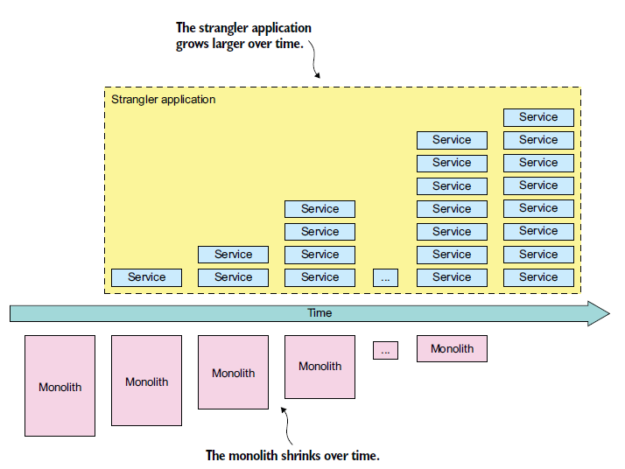
PlayerServant Strangling
Strangler pattern
  Present: All ‘micro-roles’ are in ‘CaveStorage’
  Strangling step 1:
    Replace ‘room’ calls with related
      caveservice.doThatRESTCall(….);
    … while keeing the FakeCaveStorage to handle the two other ‘micro-roles’s responsibilities….
  Strangling step 2:
    Replace micro-role 2
    Etc.
Strangle your own service first!

Slide 22
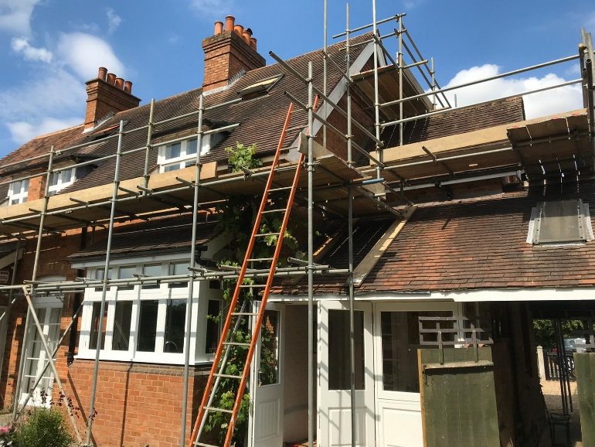
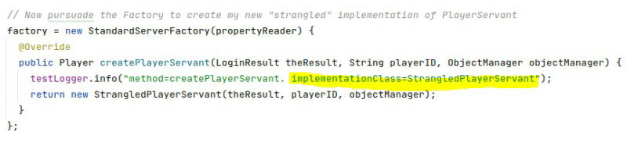
Scaffolding
Do a bit of extra work to keep tests running all the time!
  Use intermediaries, keep stuff
  that will eventually disappear…
If you ‘fall into the abyss’, consult
my own first steps of strangling…
Find a link to a document in the exercise hint section…

Slide 23
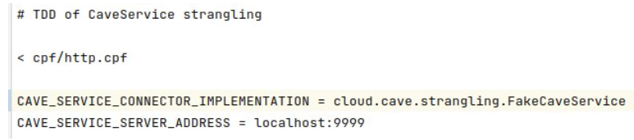

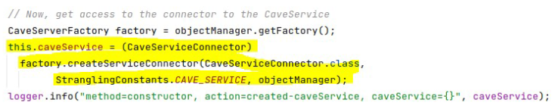
Configuring new services
SkyCave’s Factory system can read any service specification, not just the QuoteService etc.
  Obey the ‘naming’ convention, with a prefix

Slide 24
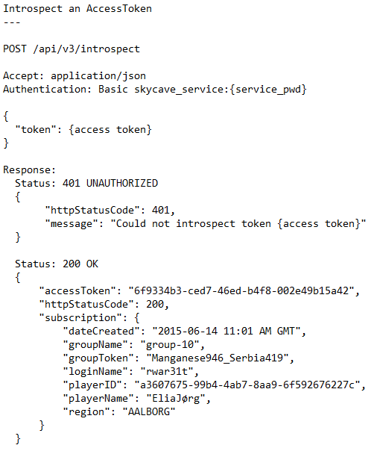
Security
You could ensure only authenticated SkyCave players are allowed to access your group’s service…
By
  Requiring ‘Authorization: Bearer (accessToken)’ header in the request…
  Do /introspect on cavereg.baerbak.com
But…
  Uhum, do not…
    The exercise is big enough as it stands.

